Slide 1
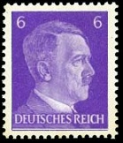
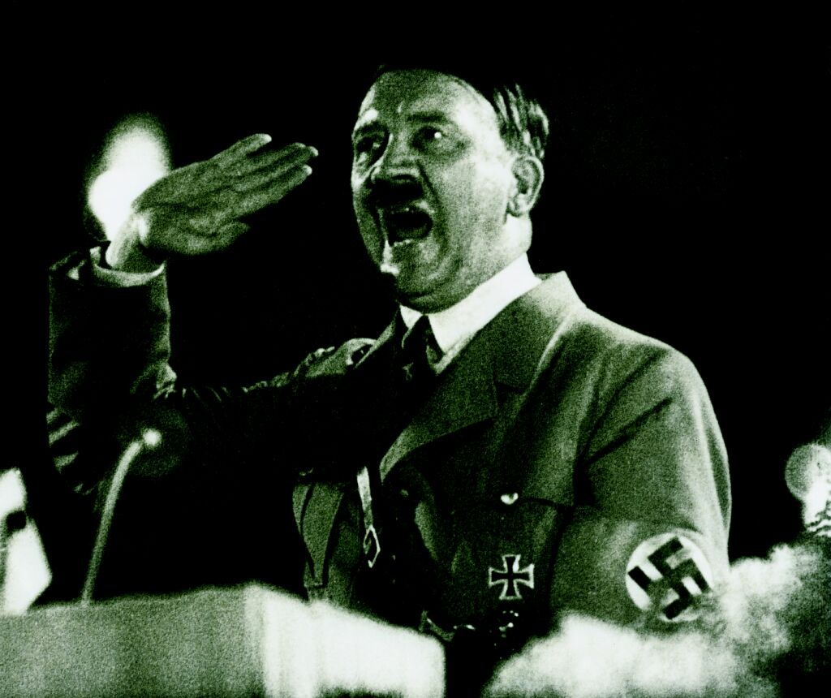
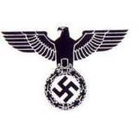
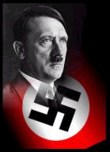
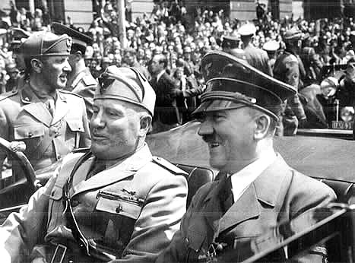
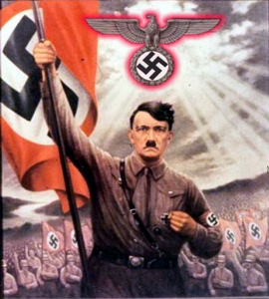
The Rise of Hitler and the Nazi Party

Slide 2
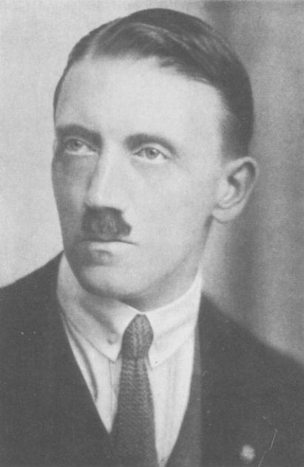
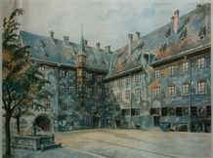
Adolf Hitler’s Early Life
Hitler was born on April 20th, 1889 in AUSTRIA
He had a poor relationship with his father and was very close to his mother
He was an aspiring painter, and was twice rejected by the Academy of Fine Arts in Vienna
It was at this time, in 1908, that Hitler
began a
movement
based on the
beliefs that
Germans were
the master
race

Slide 3
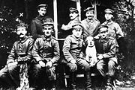
Hitler in WWI
Hitler pleaded to be in the Bavarian (a state in Germany) Army and was granted his request
He served as a messenger in a regiment that exposed him to enemy fire (story)
He was shot in the leg and suffered from a poison gas attack
He was awarded the Iron Cross – the highest military honour in Germany

Slide 4
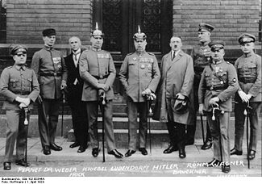
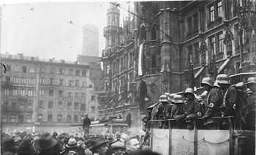
Hitler and Early Politics
Hitler helped form the National Socialist German Workers’ Party (Nazi) in 1919 and assumed leadership in 1921
Beer Hall Putsch (‘pooch’) November 8th, 1923
  Attempt by Hitler to seize power and overthrow the Bavarian government for signing the Treaty of Versailles
  The attempt failed and Hitler was imprisoned for five years for high treason (but he was released after only serving one year – he was not considered a threat to the public)

Slide 5
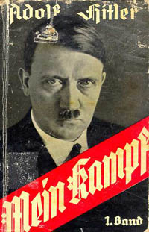
Mein Kampf
Hitler wrote Mein Kampf (“My Struggle) in 1925 while he was in prison
This became the Nazi ideology – and it attacked Jews, Communists, democracy, and the Treaty of Versailles
Hitler also wrote that Germany needed to destroy the French Nation and conquer Russia, among other things
The book sold/distributed 10 million copies between 1925-1934

Slide 6
Imprisonment and Mein Kampf Clip
http://videos.howstuffworks.com/hsw/27143-hitler-imprisonment-and-mien-kampf-video.htm
1:13 Minutes

Slide 7
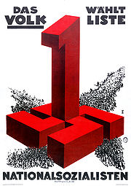
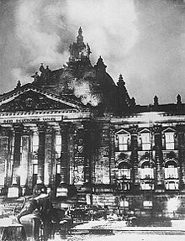
Hitler’s Rise to Power
By 1932, the Nazi Party was the biggest political party and held 230 seats
Hitler demanded to be appointed the position of chancellor – he was initially refused, but then given the position
Just before the 1933 election, the Reichstag (parliament) was burned to the ground. The president of Germany granted the Nazi Party the power to quash any political opposition, and they intimidated and arrested socialist and communist party members

Slide 8
The Reichstag Fire Clip
http://videos.howstuffworks.com/hsw/27146-hitler-hitlers-rise-after-the-reichstag-fire-video.htm
2:44 Minutes

Slide 9
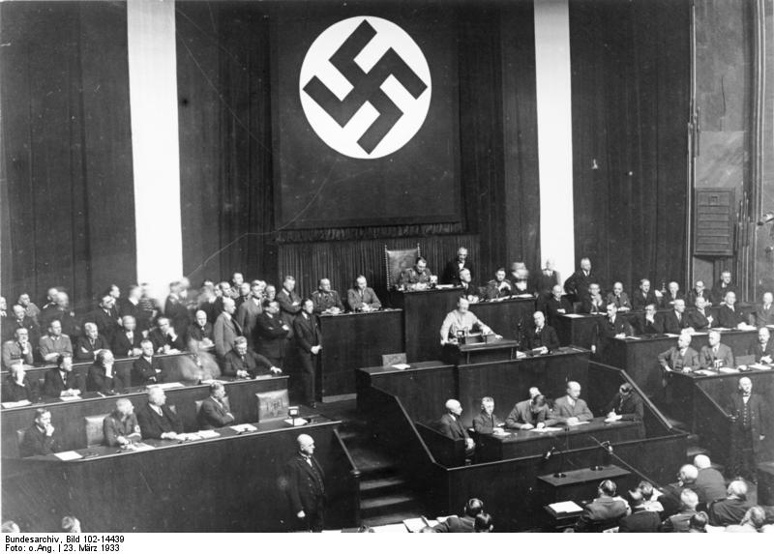
Hitler’s Rise to Power
The Enabling Act
After the 1933 election, Hitler proposed the Enabling Act, which would essentially give him a dictatorship – and it passed!
The Enabling Act…
  Banned all political parties
  Germany was declared a one
  party state
  Jews were not allowed to be
  in civil service professions
  Local and state governments
  were staffed by Nazi members

Slide 10
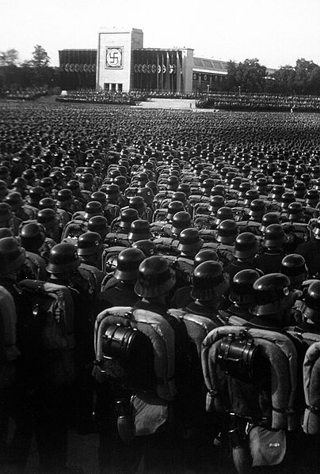
Hitler Secures Absolute Power
When the president of Germany died in 1934, Hitler’s cabinet passed a law proclaiming the presidency to him (rather than holding elections)
The military swore an oath to Hitler, not the state
Hitler had obtained absolute power, and Germany became known as the Third Reich

Slide 11
Securing Power Clip
http://videos.howstuffworks.com/hsw/27147-hitler-fuhrer-chancellor-of-the-reich-video.htm
4:17 Minutes

Slide 12
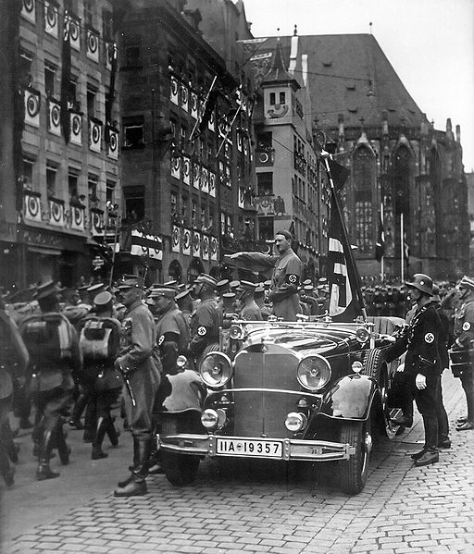
Why Vote for Hitler?
True believers
  These people shared the same ideology as Hitler and believed he was their saviour – from the depression, the Jews, the Communists, and the Treaty of Versailles
Ignorance
  People did not consider Hitler to be a real threat
Did not take him seriously
  People just thought Hitler was ‘odd’
New party needed
  The depression and hyperinflation highlighted the need for new political leadership

Slide 13
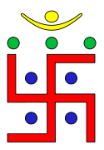

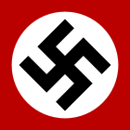
The Nazi Party
History of the Swastika
The Swastika is a religious symbol used by the Egyptians, Chinese, Roman armies, and many others
The Swastika means good luck!
The Nazi Party used the Swastika because they felt it had connections to original caste systems that avoided racial mixing
The Swastika is banned in most countries, except for religious or scholarly reasons
Jainism
Hinduism
Nazism

Slide 14

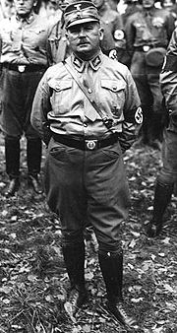
The Nazi Party
The SA (“Brown Shirts”)
Hitler’s private army
They bullied opponents into obeying
the Nazi Party
However, once Hitler rose to power, he had the SA replaced by a new organization – the SS
Night of the Long Knives
Leaders in the SA (Rohm) were killed
The SA was destroyed
Ernst Rohm

Slide 15

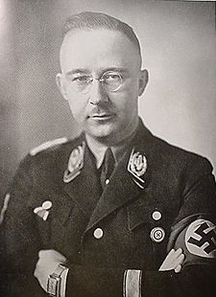
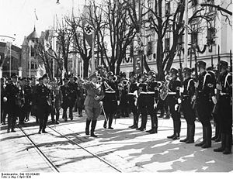
The Nazi Party
The SS (“Black Shirts”)
The SS were Hitler’s private bodyguards
and were led by Heinrich Himmler
They arrested and killed anyone who challenged Hitler
The SS took over law enforcement in Germany and implemented the ‘Final Solution’
Himmler

Slide 16
The Nazi Party
The Gestapo
The Gestapo were the secret police of Nazi Germany
They investigated treason, espionage, and sabotage cases against the Nazi Party (i.e. Valkyrie)
The Gestapo also set up and administered the concentration camps

Slide 17
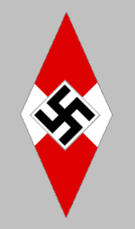
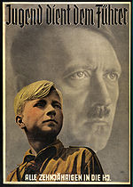
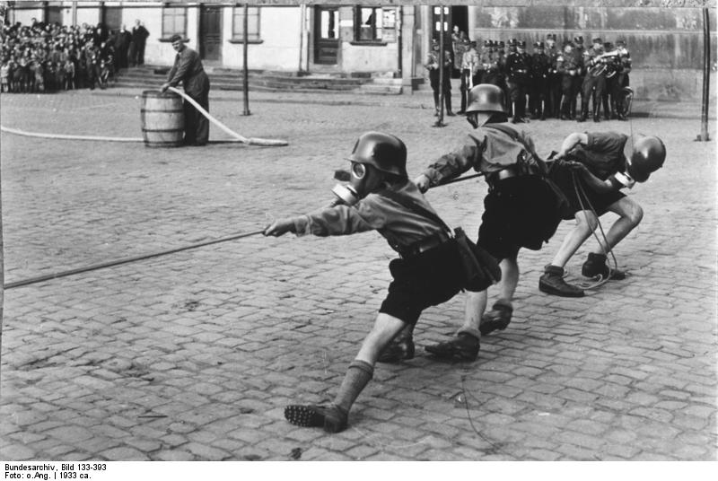
The Nazi Party
Hitler Youth
The Hitler Youth was an organization under the Nazi Party
By 1936, they had over five million
members in the organization
They were indoctrinated in anti-Semitism, and even drafted into the military ranks during WWII

Slide 18
The Hitler State
FEAR
“Otto Bauer, a 56 year old business man, said on a train in June 1942 that Germans had two alternatives: to kill Hitler or be killed by him. He was overhead by a married couple who reported him [to the Gestapo]. He was beheaded on September 16, 1943 for causing discontent and unrest.”
It was by using fear that Hitler had stopped freedom of speech and expression – everyone had to obey Nazi policy, or face the consequences!

